Slide 1
MUSIC RECOMMENDATION ENGINE
P-180 GROUP-2

Slide 2
Team members:
Mr. Prajwal C
Ms. Manali Vijay mane
Mr. Shubham Ajitkumar Sutar
Mr. Sachin Biradar
Mr. Surajkumar Yadav
Mr. Manohar kumar Sinha
Mentor – Ms. Neha Ramchandani

Slide 3
Business Objective:
The aim of this project is to build a feature of recommendation system to support a music app. As the first phase we need to develop the proof of concept to make the client understand how effective the feature could be.

Slide 4
Project Architecture / Project Flow
Data Preparation
Data Cleaning
EDA
Model Building
Model Deployment
Dataset

Slide 5
EXPLORATORY DATA ANALYSIS AND VISUALIZATION

Slide 6
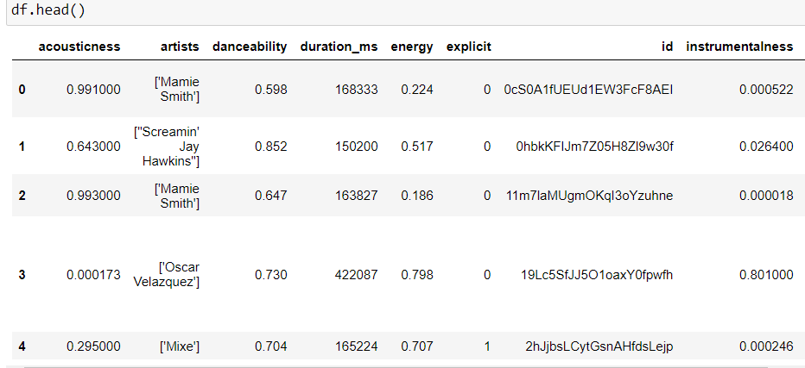
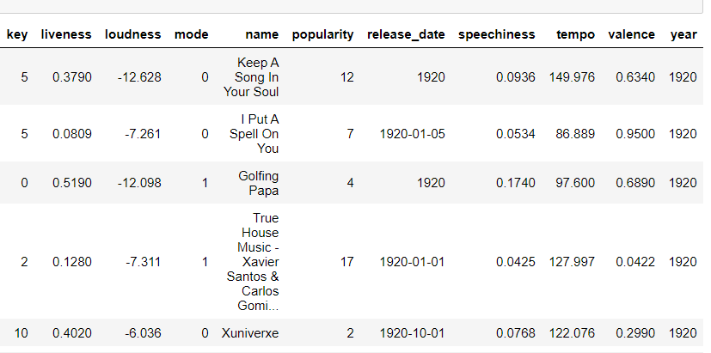

Slide 7
DATASET DETAILS:
Dataset contains 174389 Entries and 19 Features.
Spotify dataset has no missing or null values.
Spotify dataset contains 2159 duplicates rows at the beginning which is removed in subsequent EDA process.

Slide 8
Column Information:
Acousticness: Acousticness is confidence measure from 0.0 to 1.0 of whether the track is acoustic.
Danceability : Danceability measure describes how suitable a track is for dancing.
Duration_ms : duration_ms is the duration of the song track in milliseconds.
Energy : Energy represents a perceptual measure of intensity and activity.
Instrumentalness : Instrumentalness predicts whether a track contains vocals or not.
Key : Integers map to pitches using standard Pitch Class notation.
Liveness : Liveness detects the presence of an audience in the recording.
Loudness : Loudness of a track in decibels(dB).
Mode : Mode indicates the modality(major or minor) of the song.
Popularity : The popularity index is a 0-100 ‘score’ used internally by Spotify to compare and rank a track relative to ALL tracks on the platform.
Speechiness : Speechiness detects the presence of spoken words in a track.
Tempo : Tempo is in beats per minute (BPM).
Valence : Valence measures from 0.0 to 1.0 describing the musical positiveness conveyed by a track.

Slide 9
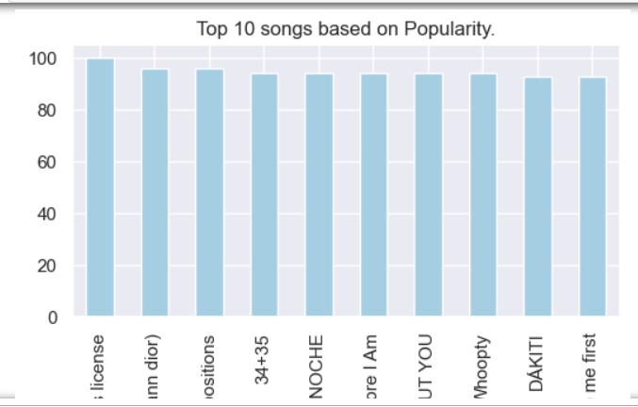
Plot for top 10 songs based on Popularity.

Slide 10
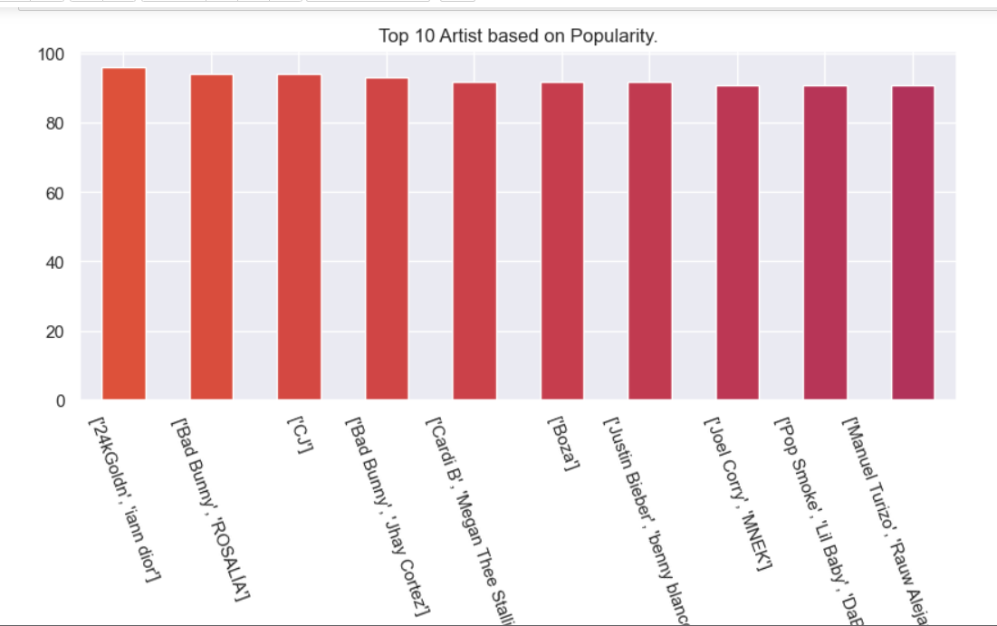
Plot for top 10 artists based on Popularity.

Slide 11
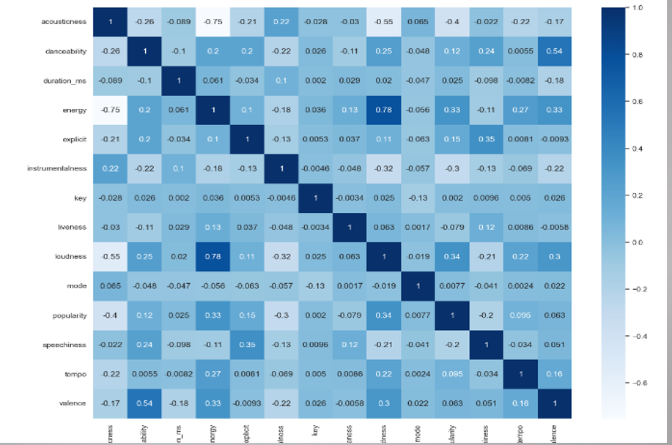
Correlation:

Slide 12
Interpretation :
Energy and Loudness having High positive correlation.
Energy and Acousticness having High negative Correlation.

Slide 13
MODEL BUILDING:

Slide 14
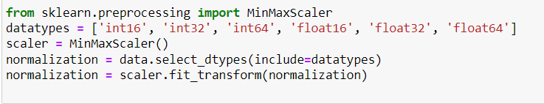
Data scaling:
We have scaled our data in the range of 0 to 1 using Normalization.

Slide 15
K-MEANS CLUSTERING:
We have used K- Means algorithm for Recommending similar songs.
We have used only those features which are in numerical form for making clusters of similar songs.
To choose optimum number of clusters (K value ) we have plotted a graph of TWSS Vs No.of clusters .

Slide 16
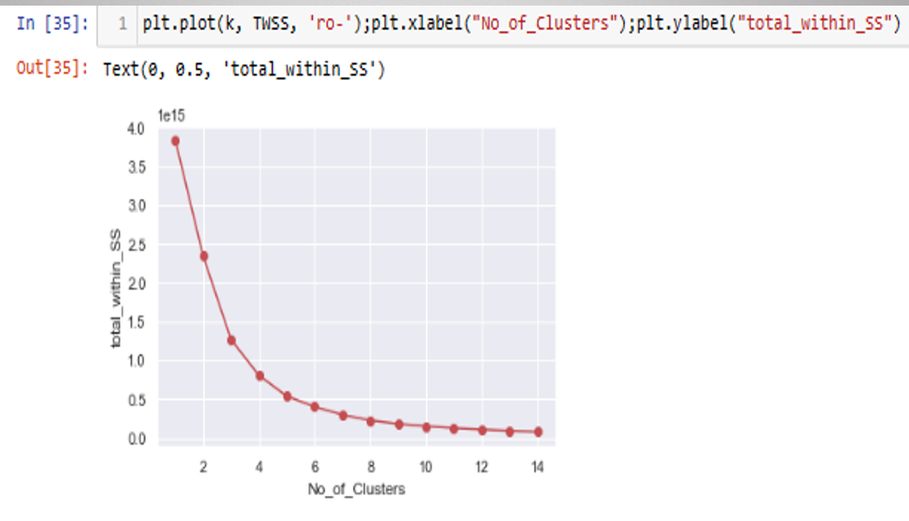
From plot shown below, We are selecting 5 as a optimum number of clusters.

Slide 17
We have created a class of ‘Spotify_Recommendation’, which has an init function that takes in dataset and assigns it to a variable ‘self-dataset’.
It also has a function ‘recommend’ which takes in a parameter ‘song’ and an optional parameter ‘amount’ and returns certain number of recommended songs based on similarity to input song.

Slide 18
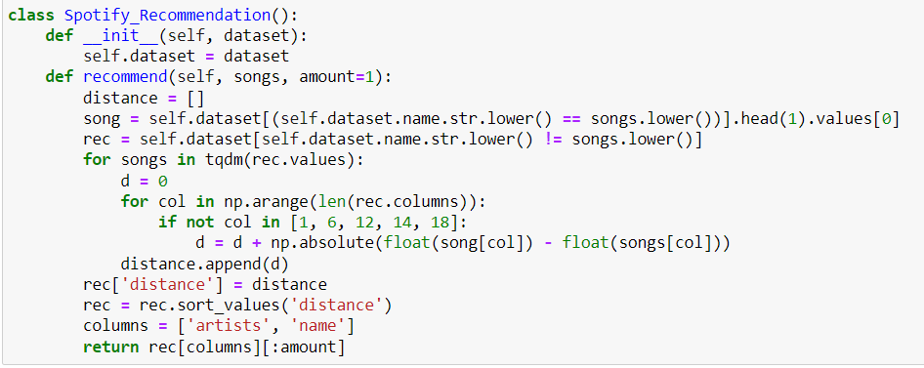

Slide 19
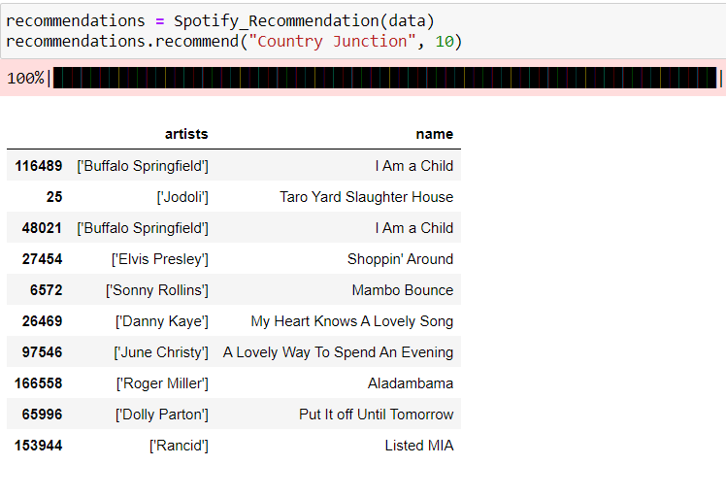

Slide 20
MODEL DEPLOYMENT

Slide 21
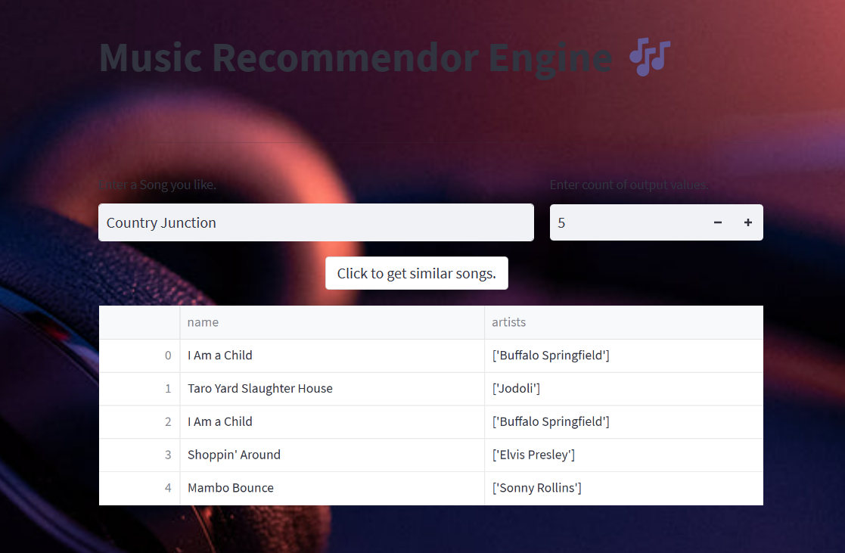

Slide 22
THANK YOU

